Slide 1
Project 5 Texture Packing
PRESENTED BY G24

Slide 2
目录
CONTENTS
Algorithm Specification
Introduction
Analysis
Testing Result
Reference
PART ONE
PART TWO
PART THREE
PART FOUR
PART FIVE
Notes:
Part 2中会介绍我们实现的三种算法 FFDH, HR和BF

Slide 3
Introduction
PART ONE

Slide 4
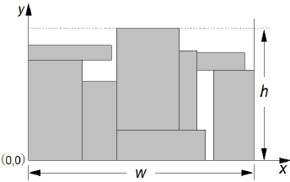
PART ONE
Texture Packing
To pack rectangles on a predefined stock sheet(fixed width) so that each rectangular piece does not overlap with another, the object is to find the minium height of the strip.
stock sheet
Notes:
解释一下stock sheet

Slide 5
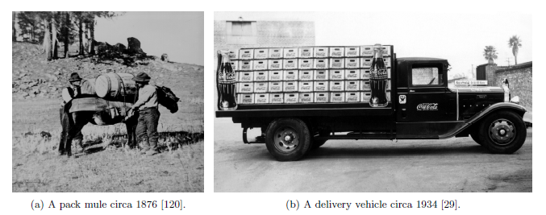
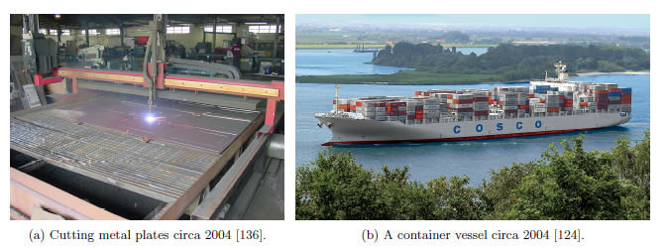
PART ONE
This problem belongs to a subset of classical cutting and packing problems(C&P) and has been shown to be NP hard.
Notes:
Early applications of packing problems in the 19th and 20th centuries
Modern C&P problems in the 21st century

Slide 6
Algorithm Specification
PART TWO

Slide 7
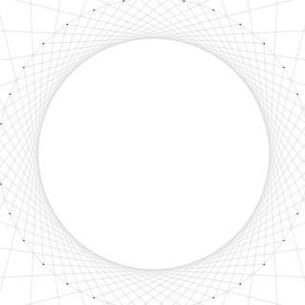
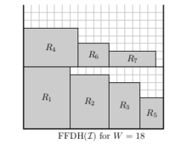
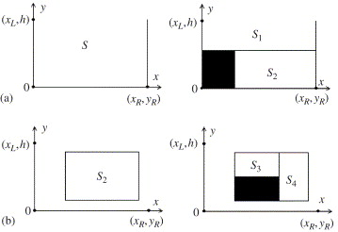
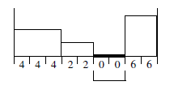
PART TWO
First Fit Decreasing Height
(FFDH)
Heuristic Recursive
(HR)
Best Fit
(BF)

Slide 8
PART TWO
First Fit Decreasing Height
All rectangles are sorted by decreasing height prior to packing.
Items are iteratively packed into the lowest level into which they fit.
If an item does not fit into any existing level, a new level is initialized.
Input Rectangles
R4
i | 1 | 2 | 3 | 4 | 5 | 6 | 7
W(i) | 6 | 5 | 4 | 7 | 3 | 4 | 6
H(i) | 8 | 7 | 6 | 5 | 4 | 3 | 2
R6
R7
R1
R2
R3
R5
W=18
Notes:
在点击鼠标出现矩形前，先说明一下该矩形的长和宽

Slide 9
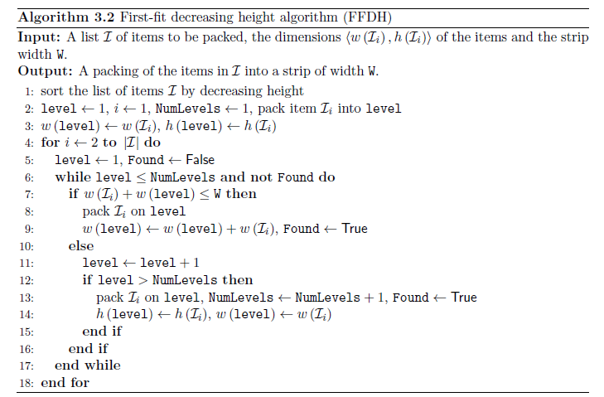
PART TWO
Pseudocode for FFDH

Slide 10
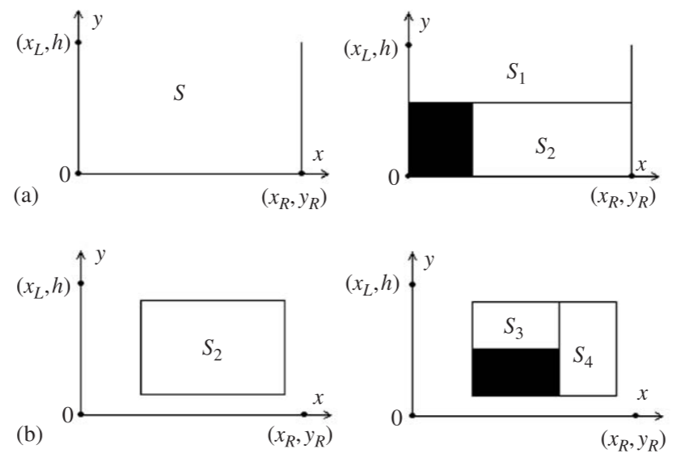
PART TWO
Heuristic Recursive（HR）
A typical Divide and Conquer Algorithm
1. Pack a rectangle into the space to be packed. Divide the unpacked space into two subspaces
2. Pack each subspaces by packing them recursively. If the subspace size are small enough to only pack a rectangle, however, just pack this rectangle into the subspace in a straightforward manner.
3. Combine the solutions to the subproblems into the solution for the rectangle packing problem.
Notes:
建议看下原论文，结合图讲述（两种情况 a & b）

Slide 11
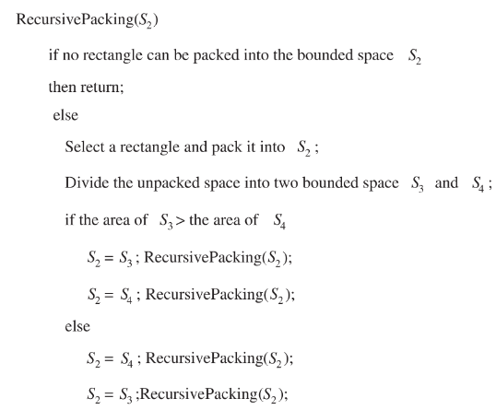
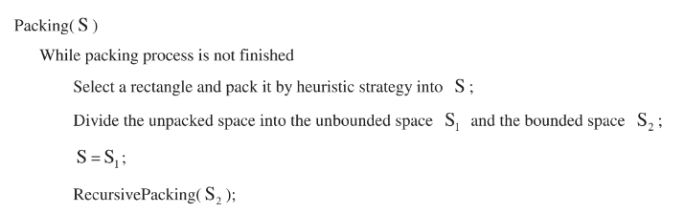
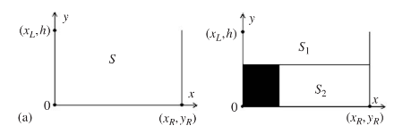
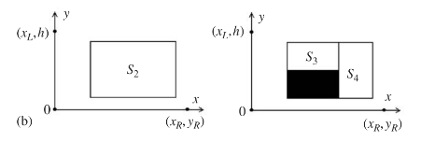
Heuristic Recursive（HR）
PART TWO
Bounded Area
UnBounded Area
Notes:
值得注意的是，如何选择rectangle极大地影响到了算法的效率。我们采用的是优先选择面积最大的矩形。所以我们在packing前会对矩形进行排序

Slide 12
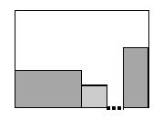
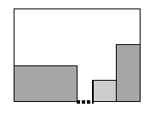
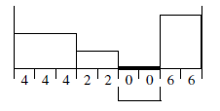
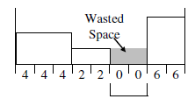
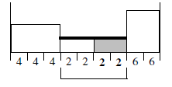
PART TWO
Best Fit
Always pack the best-fitting rectangle to the lowest available space.
There exist shapes with a dimension (either width or height) that exactly fits the gap
There is a shape with a dimension smaller than the gap. In this case, we choose the shape which consumes the largest portion of the gap.
Left-most
Tallest-Neighbor
Shortest-Neighbor
R4
R1
R2
R3
There are no shapes that will fit the gap(all larger than the gap).
Notes:
最后一种情况，如果当前找不到合适的矩形，在接下来的搜索过程中也不可能找到，所以这么做是合理的

Slide 13
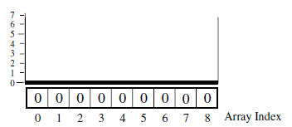
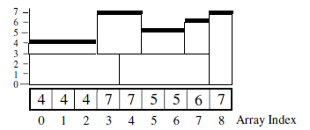
PART TWO
Best Fit – Preprocessing Stage
To find the lowest available space skyline[ ]
To find the best-fitting rectangle sort
rotate any rectangle for which the height is greater than the width.
{(3,5),(5,2),(1,1),(7,3),(1,2)} becomes {(5,3),(5,2),(1,1),(7,3),(2,1)}
the list of rectangles is sorted into decreasing width
order (resolving equal widths by decreasing heights)
{(5,3),(5,2),(1,1),(7,3),(2,1)} becomes {(7,3),(5,3),(5,2),(2,1),(1,1)}
Notes:
Example: Fixed width=9

Slide 14
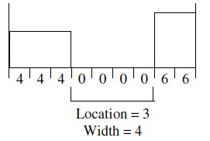
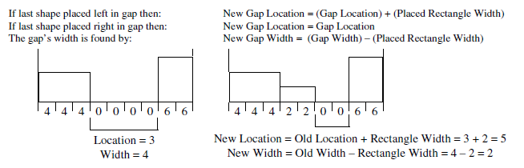
PART TWO
Best Fit – Packing Stage
1) Find the position and the width of the lowest gap
2) Find Find the best-fitting rectangle
{(7,3),(5,3),(5,2),(2,1),(1,1)} Gap width = 6
{(7,3),(5,3),(5,2),(2,1),(1,1)} Gap width = 4
3) Assign cooridinates
(7,3)
(5,3)
(5,2)
(7,3)
(5,3)
4) Remove the rectangle from the rectangle list
5) Update the stock-sheet array (skyline[ ])
Notes:
建议看下原论文

Slide 15
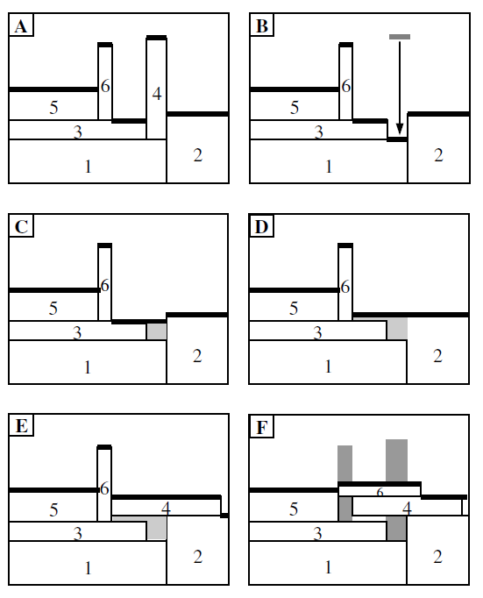
Best Fit – Postprocessing Stage
PART TWO
while Optimization Not Finished do
Find Highest Shape
if (Shape Width ≥ Shape Height) then
Optimization Finished
end if
Remove Highest Shape
Reduce Array to Reflect Skyline
Rotate Shape by 90 Degrees
while(Shape Not Fits)
Raise Gap to Lowest Neighbor
end while
Place Best-Fitting Rectangle Using Placement Policy
Raise Array to Reflect Skyline
if(Packing Better == False)then
Optimization Finished
end if
end while
Notes:
这种算法的一个劣势是会产生tower，所以在最后需要调整。结合伪代码描述以下右图的调整过程

Slide 16
Analysis
PART THREE

Slide 17
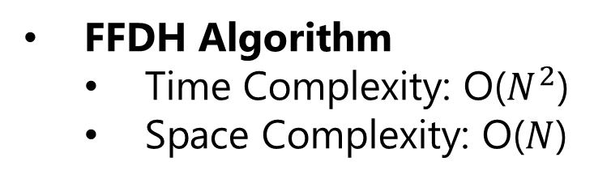
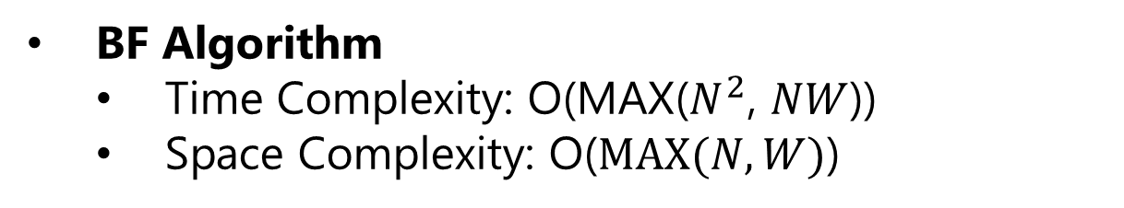
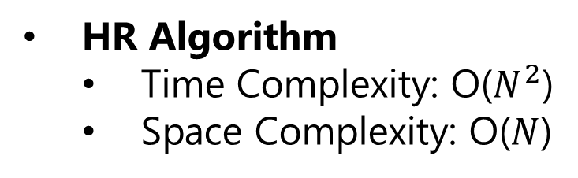
PART THREE
FFDH Algorithm
Time Complexity: O($N^{2}$)
Space Complexity: O($N$)
HR Algorithm
Time Complexity: O($N^{2}$)
Space Complexity: O($N$)
BF Algorithm
Time Complexity: O(MAX($N^{2}$, $NW$))
Space Complexity: O($MAX(N,W)$)

Slide 18
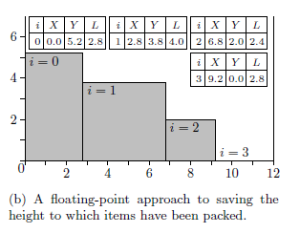
PART THREE
Factors which might affect the approximation ratio
The shape of the rectangles
Floating-point Data
Convert floating-point data to integer format by multiplying each rectangle by a scaling factor
Floating-point data approach(Burke 2006)
Notes:
Burke suggests the use of an array of triples (3-tuples).This data structure notes the horizontal coordinate of a change in height, the height (or vertical coordinate) of the skyline to the right of that point and the length of the region between subsequent changes in height.

Slide 19
Testing Results
PART FOUR

Slide 20
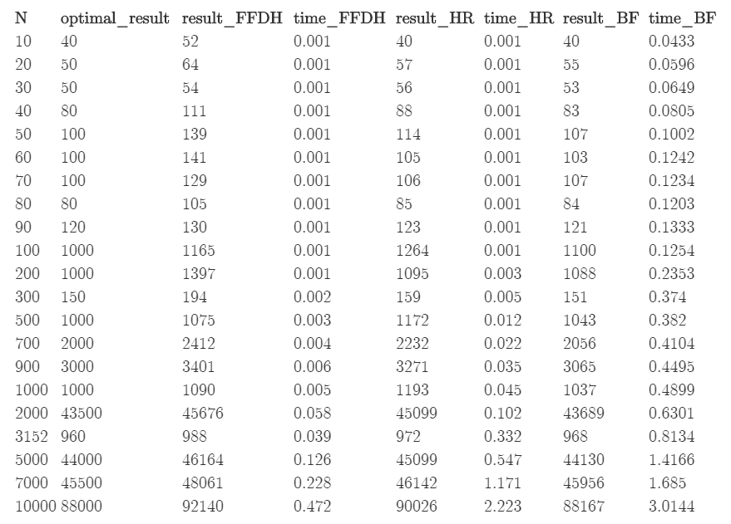
Run time & Result Table

Slide 21
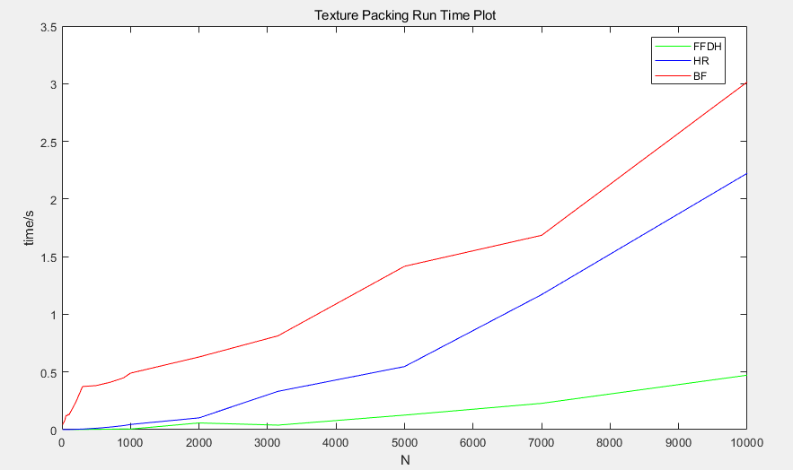
PART FOUR

Slide 22
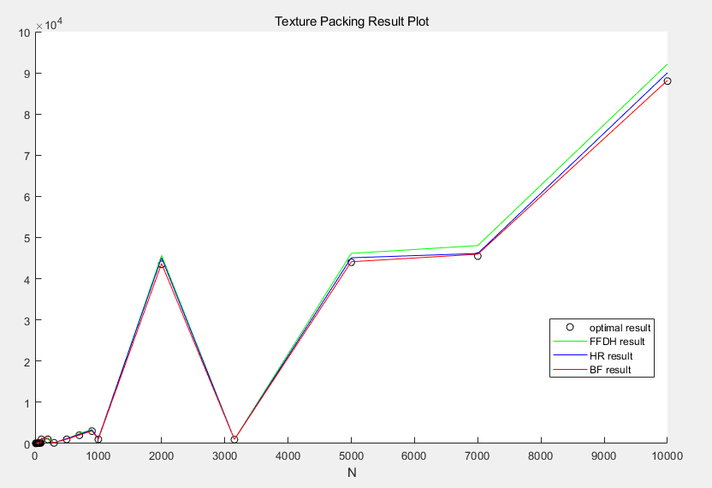
PART FOUR

Slide 23
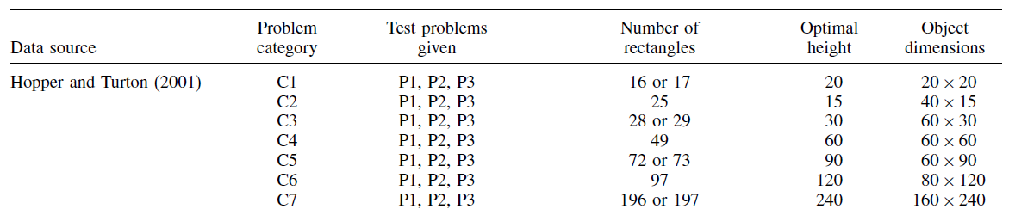
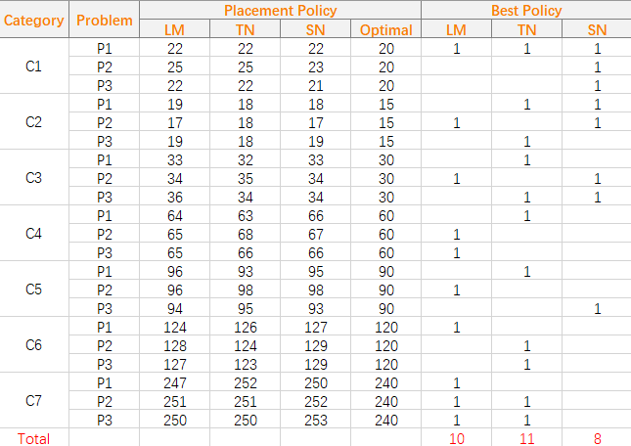
PART FOUR
A comparison of the Placement Policies in BF
Notes:
先介绍data source，然后说一下测试结果

Slide 24
Reference
PART FIVE

Slide 25
PART FIVE
Reference
[ 1 ]: Frank Gerald Ortmann. Heuristics for Offline Rectangular Packing Problems [D]. South Africa: Stellenbosch University, 2010.
[ 2 ]: E. K. Burke, G. Kendall, G. Whitwell. A New Placement Heuristic for the Orthogonal
Stock-Cutting Problem [J]. OPERATIONS RESEARCH. 2004, 52(4): 655–671
[ 3 ]: Defu Zhang, Yan Kang, Ansheng Deng. A new heuristic recursive algorithm for the strip rectangular packing problem[J]. Computer & Operations Research, 2006, 33(8): 2209-2217.

Slide 26
THANK YOU FOR WATCHING
PRESENTED BY G24

